Slide 1
Waters of the United States
(WOTUS) Update
Phyllis Feinmark
Chief, Water and General Law Branch
US EPA Region 2 ORC
May 19, 2023

Slide 2
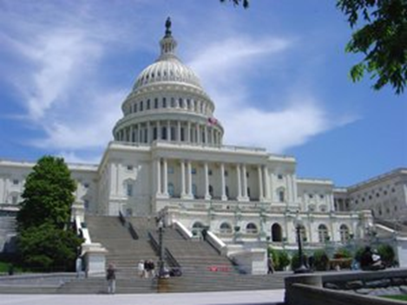
Background: “Waters of the United States” and the Clean Water Act
  “Waters of the United States” is a threshold term in the Clean Water Act that establishes the geographic scope of federal jurisdiction under the Act.
  Clean Water Act regulatory programs address “navigable waters,” defined in the statute as “the waters of the United States, including the territorial seas.”
  The Clean Water Act does not define “waters of the United States”; Congress left further clarification to the agencies.
  EPA and the Department of the Army have defined “waters of the United States” by regulation since the 1970s.

Slide 3
Background: Why “Waters of the United States” Matters
“Navigable Waters”: Waters of the United States,
including Territorial Seas
303
Water
Quality
Standards
& TMDLs
311
Oil Spill
Programs
401
State/Tribal
Certification
402
Pollutant
Discharge
Permits
404
Discharge of dredged and/or fill material
EPA
USCG
DOT
States
Tribes
EPA
States
Tribes
EPA
USACE
EPA
States
Tribes
States
Tribes
EPA

Slide 4
Many Regulations Incorporate the “Waters of the US” Definition
  33 CFR Part 328 - Army COE Section 404 Regulations
  40 CFR Part 110 - Discharge of Oil
  40 CFR Part 112 - Oil Pollution Prevention
  40 CFR Part 116 - Designation of Hazardous Substance
  40 CFR Part 117 - Determination of Reportable Quantities for Hazardous Substances
  40 CFR Part 122 - EPA Administered Permit Programs: NPDES
  40 CFR Part 230 - Section 404(b)(1) Guidelines
  40 CFR Part 232 - 404 Program Definitions; 404 Exempt Activities
  40 CFR Part 300 - National Oil and Hazardous Substances Pollution
  40 CFR Part 300 (App E) - Oil Spill Response
  40 CFR Part 302 - Designation, Reportable Quantities, and Notification
  40 CFR Part 401 - General Provisions

Slide 5
Background: “Waters of the United States” Over Time
The definition of “waters of the United States” has been a subject of dispute and addressed in several major Supreme Court cases.
1973-1979: EPA & Corps issue regs and revisions
1985: Riverside Bayview Homes (addressing adjacent wetlands)
2001: SWANCC (addressing “other waters); agencies issue guidance in 2001 and 2003
Previous final rules revising the definition in 2015, 2019, and 2020
1972: WOTUS used in CWA definition for “navigable waters”
1975: NRDC v. Callaway (finding the Corps’ 1974 regs to be too narrow)
1980: Addition of waste treatment system exclusion
1986/1988: Corps and EPA issue revised regulations
1993: Addition of exclusion for prior converted cropland
2006: Rapanos (adjacent wetlands to non-navigable tributaries); guidance in 2007 and 2008

Slide 6
A Very Brief History of WOTUS - Part 1
July 1977 – First definition of “waters of the US” in Corps regulations
July 1985 – United States v. Riverside Bayview Homes
June 1988 – Last modification of the EPA regulatory definition (until 2015 CWR)
Jan 2001 – SWANCC: Narrows jurisdiction for isolated waters
June 2006 – Rapanos: Addresses “relatively permanent waters” & “significant nexus”

Slide 7
Redefining WOTUS
After SWANCC and Rapanos, call for EPA and the Army Corps to do rulemaking to
define “waters of the US”
  Cases had created confusion and uncertainty over the exact definition of waters of the United States
  Decisions did not invalidate the longstanding regulatory definition, but did provide important qualifiers on how the definition should be implemented
Guidance was helpful, but can’t provide the type of specificity stakeholders requested
  Can’t define terms
  Can’t create or modify rights or obligations
As a result, the agencies began a rulemaking effort early in 2011

Slide 8
A Very Brief History of WOTUS Cont’d - the Clean Water Rule
Aug 28, 2015 – Original effective date for CWR (80 FR 37054, June 29, 2015)
Oct 9, 2015 – Nationwide Stay of CWR by the 6th Cir. Court of Appeals
– return to the 1986 rule plus guidance and applicable case law

Slide 9
2017 Executive Order
Presidential Executive Order 13778 signed on Feb. 28, 2017
  Entitled “Presidential Executive Order on Restoring the Rule of Law, Federalism, and Economic Growth by Reviewing the ‘Waters of the United States’ Rule”
  Calls for EPA and Army Corps to review the final Clean Water Rule and “publish for notice and comment a proposed rule rescinding or revising the rule…”
  Agencies “shall consider interpreting the term ‘navigable waters’ in manner consistent with Justice Scalia’s opinion” in Rapanos.”

Slide 10
The Navigable Waters Protection Rule (NWPR)
March 6, 2017 - Federal Register notice (82 FR 12532)
In accordance with EO, announcing EPA and Corps “intention to review and rescind or revise the Clean Water Rule.
October 22, 2019 - Step 1
Rule repealing the 2015 CWR, recodifying the regulatory text that existed prior to 2015.
June 22, 2020 - Step 2
Navigable Waters Protection Rule 33 CFR Part 328 (Corps of Engineers), 40 CFR Part 120 (EPA)

Slide 11
Fast Forward to January 20, 2021
EO 13990 (1/20/21) “Protecting Public Health and the Environment and Restoring Science to Tackle Climate Change”
  Emphasis on science
  Revoked EO 13778; but that did not revoke the regulation
  NWPR went on a list of regulations agencies were directed to review

Slide 12
And then . . . .
  June 9, 2021 determination by EPA and US Army Corps of Engineers:
  NWPR is causing significant, ongoing, and irreversible environmental damage
  Should be replaced with a “durable” definition of waters of the US
  Pascua Yaqui Tribe v. EPA (D. Ariz.) – remanded and vacated on August 30, 2021.
  Navajo Nation v. Regan (D.N.M.) – remanded and vacated on September 27, 2021.

Slide 13
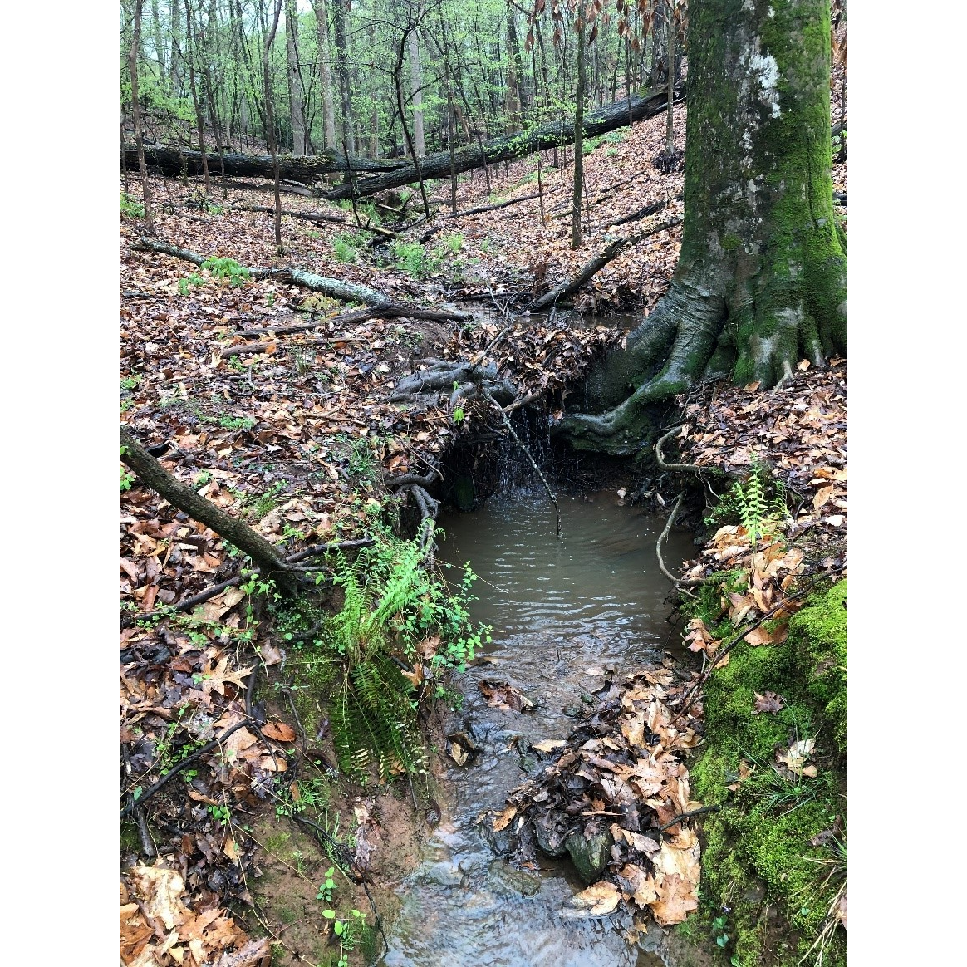
Background: Rulemaking Process
Summer 2021 | Consultations and pre-proposal input
December 2021 | Proposed rule published in the Federal Register
February 2022 | Public comment period closed
September 2022 | Final rule package submitted to OMB for interagency review
December 2022 | Final rule signed – “Revised Definition of ‘Waters of the United States’”
Early 2023 | Trainings with Federal agencies, Tribes, States, and the public
March 20, 2023 | Final rule effective (60 days after January 18, 2023 publication in the Federal Register)

Slide 14
Rule Status and Litigation Update
The final "Revised Definition of 'Waters of the United States'" rule was published in the Federal Register on January 18, 2023 and the rule took effect on March 20, 2023.
However, the final rule is not currently operative in certain states and for certain parties due to litigation.
The agencies are reviewing the decisions and their options.
https://www.epa.gov/wotus/definition-waters-united-states-rule-status-and-litigation-update

Slide 15
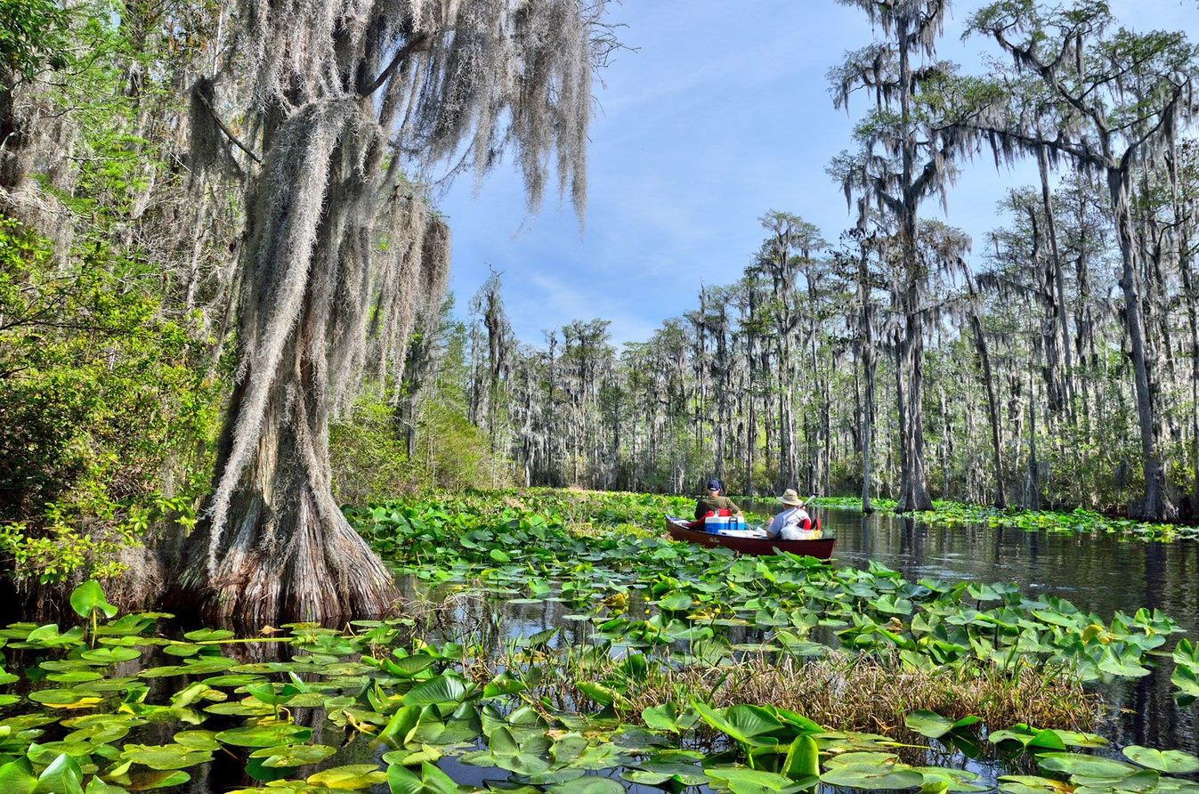
Final Rule Framework
The agencies are interpreting “waters of the United States” to mean the waters defined by the familiar pre-2015 regulations, with amendments to reflect the agencies’ determination of the statutory limits on the scope of “waters of the United States” informed by Supreme Court precedent, the best available science, and the agencies’ experience and technical expertise.
The final rule is organized in three parts:
  (a) Jurisdictional Waters
  (b) Exclusions
  (c) Definitions

Slide 16
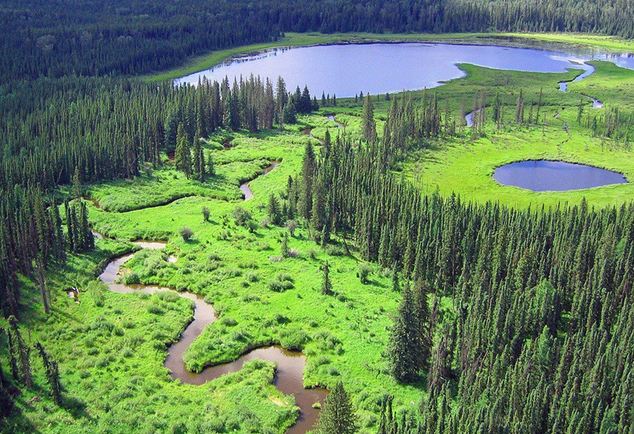
Final Rule Framework
Categories of Jurisdictional Waters
  (a)(1)
    (i) Traditional Navigable Waters
    (ii) Territorial Seas
    (iii) Interstate Waters
  (a)(2) Impoundments of Jurisdictional Waters
  (a)(3) Tributaries
  (a)(4) Adjacent Wetlands
  (a)(5) Intrastate lakes and ponds, streams, and wetlands that do not fall within (a)(1) – (a)(4)
*NOTE: The categories of jurisdictional waters listed on this slide are shorthand categories that are being used for efficiency. See the final regulatory text at 33 CFR 328.3(a) and 40 CFR 120.2(a) for the full text of the categories.

Slide 17
Final Rule Framework
Exclusions
(b)(1) Waste treatment systems
(b)(2) Prior converted cropland
(b)(3) Certain ditches
(b)(4) Artificially irrigated areas that would revert to dry land if irrigation ceased
(b)(5) Certain artificial lakes and ponds
(b)(6) Artificial reflection or swimming pools or other small ornamental bodies of water
(b)(7) Certain waterfilled depressions
(b)(8) Swales and erosional features
(b)(1) – (b)(2):
Pre-2015 exclusions, modified in the final rule
(b)(3) – (b)(8):
Pre-2015 “generally non-jurisdictional features,” added to the final rule as exclusions
*NOTE: The categories of exclusions that are listed on this slide are shorthand categories that are being used for efficiency. See the final regulatory text at 33 CFR 328.3(b) and 40 CFR 120.2(b) for the full text of the categories.

Slide 18
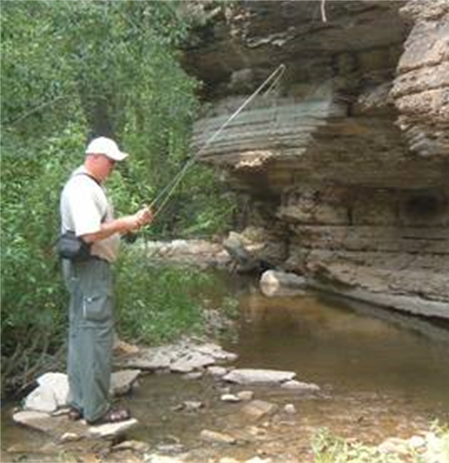

Final Rule Framework
Definitions
(c)(1) Wetlands
(c)(2) Adjacent
(c)(3) High tide line
(c)(4) Ordinary high water mark
(c)(5) Tidal waters
(c)(6) Significantly affect
(c)(1) – (c)(5):
Pre-2015 definitions, with no changes
(c)(6):
New term and definition in the final rule

Slide 19
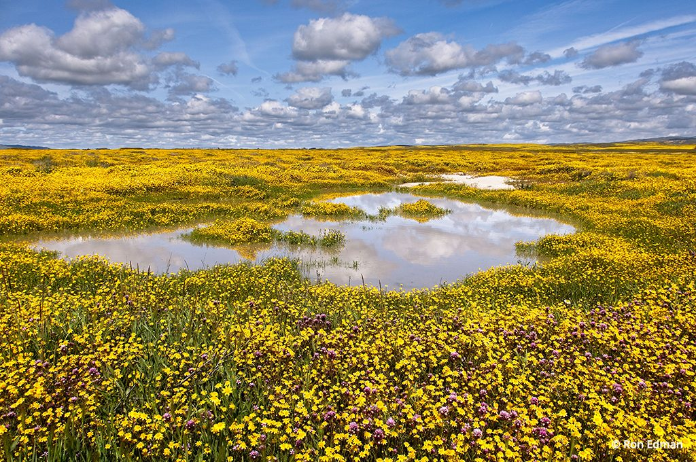
Key Concepts
The “relatively permanent standard” means relatively permanent, standing or continuously flowing waters connected to paragraph (a)(1) waters, and waters with a continuous surface connection to such relatively permanent waters or to paragraph (a)(1) waters.
The ‘‘significant nexus standard’’ means waters that either alone or in combination with similarly situated waters in the region, significantly affect the chemical, physical, or biological integrity of paragraph (a)(1) waters.

Slide 20
Significantly Affect – applies to tributaries, adjacent wetlands, and (a)(5) waters
The final rule text specifies that “significantly affect” requires a “material influence” on the chemical, physical, or biological integrity of an (a)(1) water.
The final rule text includes functions to be assessed:
(A) Contribution of flow;
(B) Trapping, transformation, filtering, and transport of materials (including nutrients, sediment, and other pollutants);
(C) Retention and attenuation of floodwaters and runoff;
(D) Modulation of temperature in waters identified in paragraph (a)(1) of this section; or
(E) Provision of habitat and food resources for aquatic species located in waters identified in paragraph (a)(1) of this section.

Slide 21
Significantly Affect – applies to tributaries, adjacent wetlands, and (a)(5) waters
The final rule text specifies that “significantly affect” requires a “material influence” on the chemical, physical, or biological integrity of an (a)(1) water.
The final rule text includes factors to consider:
(A) The distance from a water identified in paragraph (a)(1) of this section;
(B) Hydrologic factors, such as the frequency, duration, magnitude, timing, and rate of hydrologic connections, including shallow subsurface flow;
(C) The size, density, or number of waters that have been determined to be similarly situated;
(D) Landscape position and geomorphology; and
(E) Climatological variables such as temperature, rainfall, and snowpack.

Slide 22
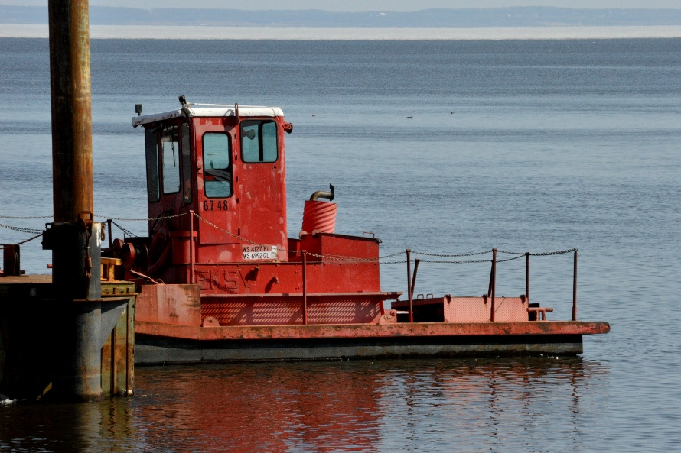
(a)(1) Waters – Traditional Navigable Waters, the Territorial Seas, and Interstate Waters
  Traditional Navigable Waters
    Waters which are currently used, or were used in the past, or may be susceptible to use in interstate or foreign commerce, including all waters which are subject to the ebb and flow of the tide.

Slide 23

(a)(1) Waters – Traditional Navigable Waters, the Territorial Seas, and Interstate Waters
  The Territorial Seas
    Defined in section 502(8) of the Clean Water Act as “the belt of the seas measured from the line of ordinary low water along that portion of the coast which is in direct contact with the open sea and the line marking the seaward limit of inland waters, and extending seaward a distance of three miles.”

Slide 24
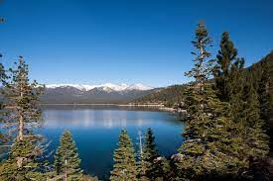
(a)(1) Waters – Traditional Navigable Waters, the Territorial Seas, and Interstate Waters
  Interstate Waters
    “Waters of the United States” include interstate waters, including wetlands.
    The preamble clarifies implementation of interstate waters:
      Lakes, ponds, and wetlands crossing state boundaries are jurisdictional as interstate waters in their entirety.
      For rivers and streams, interstate waters include the portion of the river or stream that is of the same stream order as the point that crosses or serves as a state line.
      The agencies plan to address waters that cross between state and tribal boundaries in a future action.

Slide 25
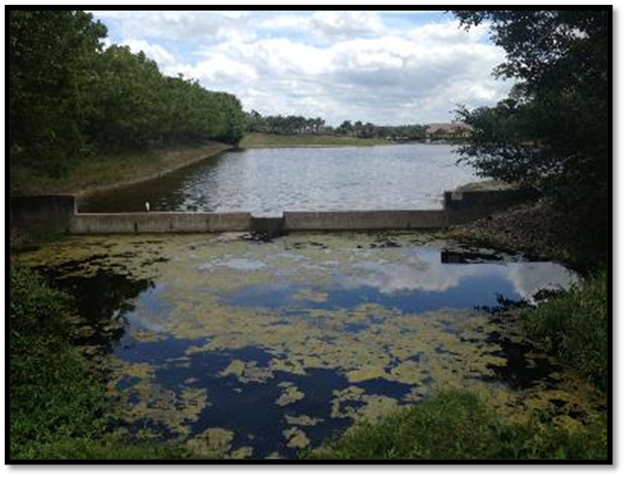
(a)(2) Impoundments
  “Waters of the United States” include impoundments of waters that otherwise meet the definition of “waters of the United States.”
  However, waters determined to be jurisdictional under paragraph (a)(5), and that are subsequently impounded, do not retain their jurisdictional status under this (a)(2) impoundments provision. Such waters may still be determined to be jurisdictional under another rule category.

Slide 26
(a)(2) Impoundments
The agencies consider paragraph (a)(2) impoundments to include:
(1) Impoundments created by impounding one of the “waters of United States” that was jurisdictional under this rule’s definition at the time the impoundment was created, and
(2) Impoundments of waters that at the time of assessment meet the definition of “waters of the United States” under paragraph (a)(1), (a)(3), or (a)(4) of this rule, regardless of the water’s jurisdictional status at the time the impoundment was created.

Slide 27
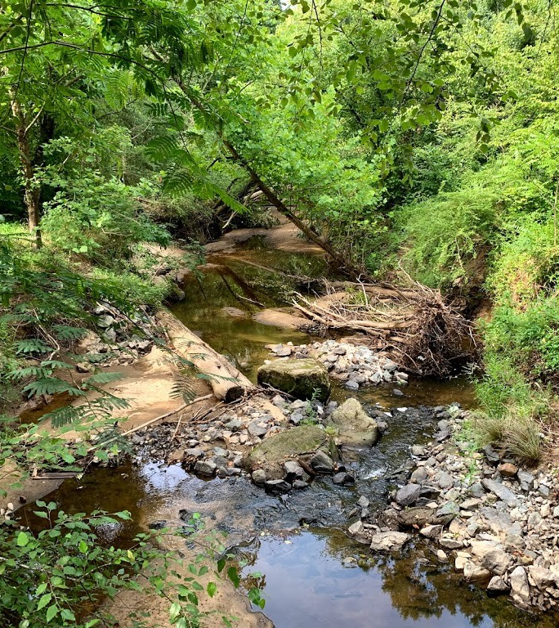
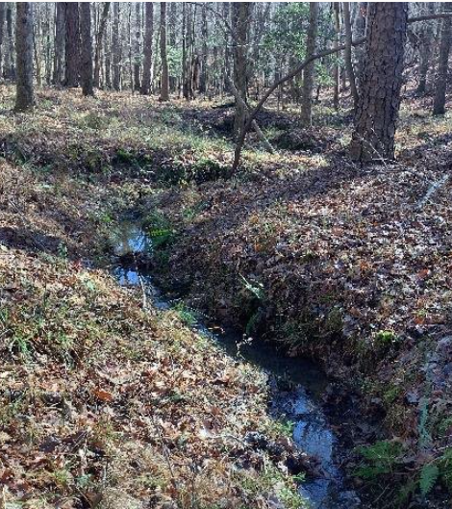
(a)(3) Tributaries
  Tributaries include natural, man-altered, or man-made water bodies that flow directly or indirectly into (a)(1) waters or (a)(2) impoundments.
    Tributaries can include rivers, streams, lakes, ponds, and impoundments.
    Tributaries can also include ditches and canals.
  Jurisdictional tributaries must meet either:
    The relatively permanent standard OR
    The significant nexus standard

Slide 28
(a)(3) Tributaries
  Relatively Permanent Standard
  Relatively permanent waters include tributaries that have flowing or standing water year-round or continuously during certain times of year.
  Relatively permanent waters do not include tributaries with flowing or standing water for only a short duration in direct response to precipitation.
  Waters that do not meet the relatively permanent standard must be assessed under the significant nexus standard.

Slide 29
(a)(3) Tributaries
  Significant Nexus Standard
  Tributaries meet the significant nexus standard if they either alone or in combination with similarly situated waters in the region, significantly affect the chemical, physical, or biological integrity of paragraph (a)(1) waters.
  The 2023 Rule preamble explains the scope of significant nexus (i.e., which waters are “similarly situated” “in the region”).
    Adjacent wetlands and tributaries are aggregated together within the catchment of the tributary of interest.

Slide 30
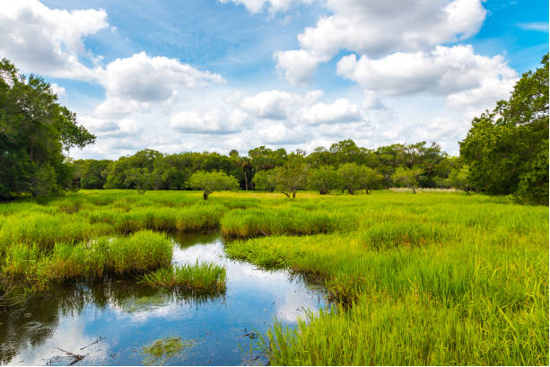
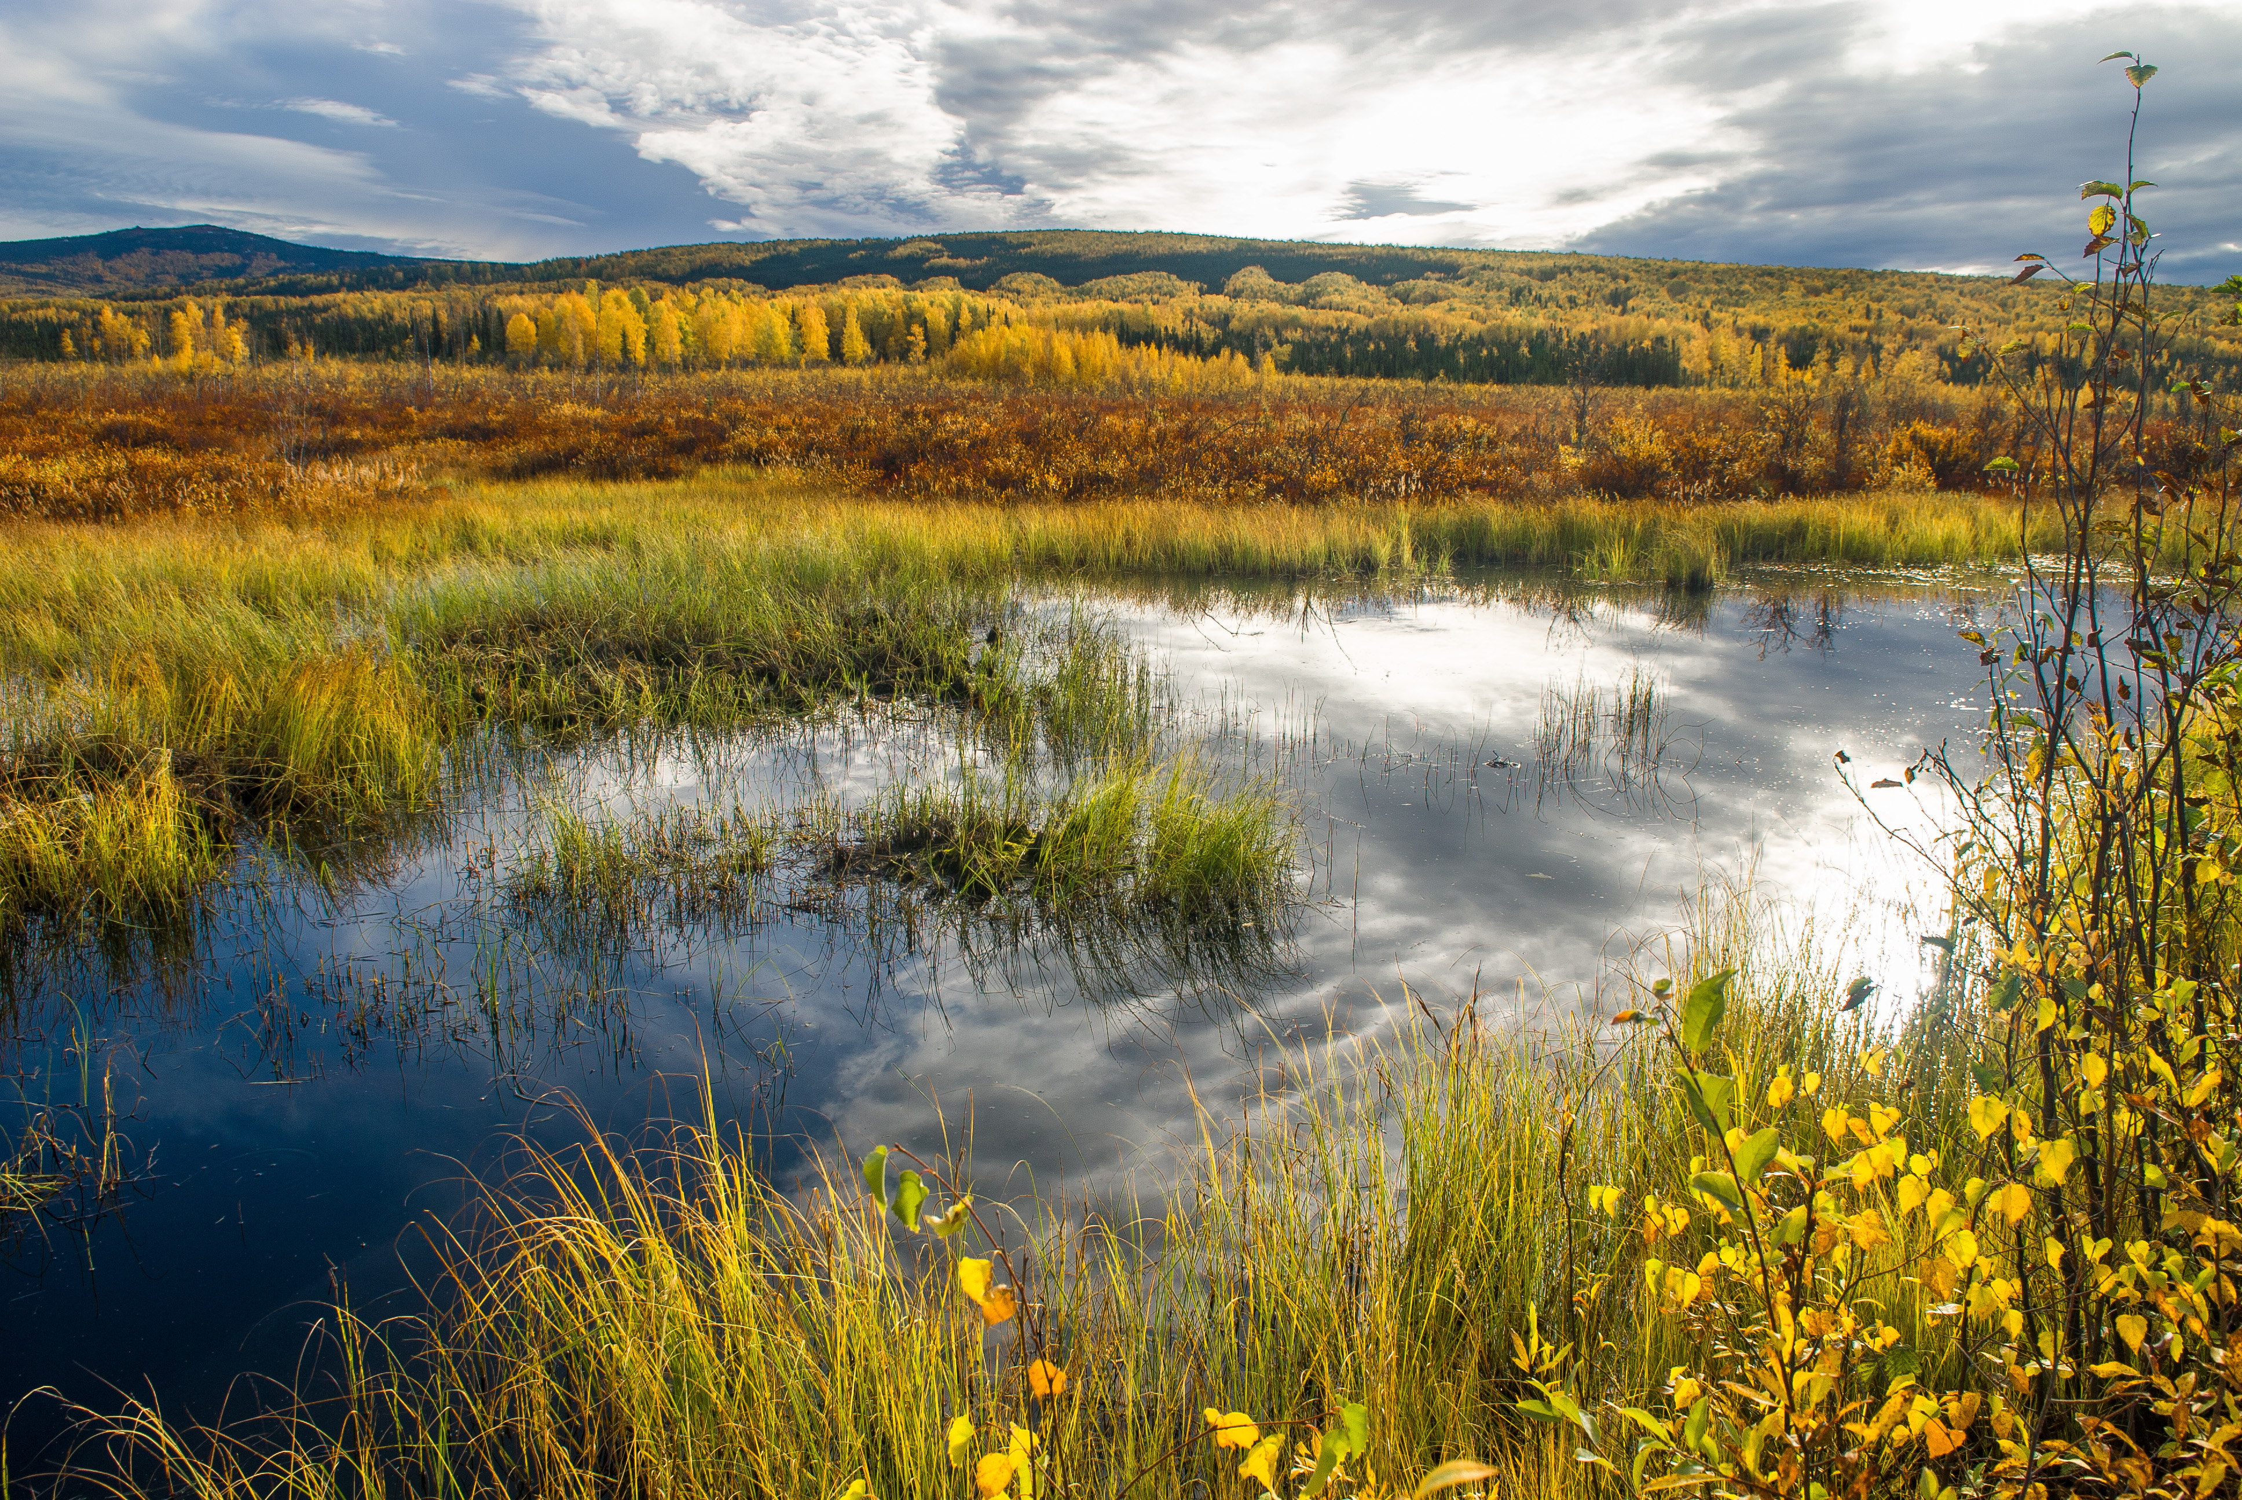
(a)(4) Adjacent Wetlands
  The final rule includes the agencies’ longstanding definitions of “wetlands” and “adjacent.”
    Wetlands means those areas that are inundated or saturated by surface or ground water at a frequency and duration sufficient to support, and that under normal circumstances do support, a prevalence of vegetation typically adapted for life in saturated soil conditions. Wetlands generally include swamps, marshes, bogs, and similar areas.
    Adjacent means bordering, contiguous, or neighboring. Wetlands separated from other waters of the United States by man-made dikes or barriers, natural river berms, beach dunes, and the like are “adjacent wetlands.”

Slide 31
(a)(4) Adjacent Wetlands
  The agencies have three well-established criteria to determine adjacency; if any one of the criteria is met, the wetland is “adjacent,” but may require further analysis to determine if it is “waters of the United States.”
  First, there is an unbroken surface or shallow subsurface connection to a jurisdictional water.
  Second, the wetland is physically separated from a jurisdictional water by human-made dikes or barriers, or natural landforms (e.g., river berms, beach dunes).
  Or third, the wetland’s proximity to a jurisdictional water is reasonably close such that “adjacent wetlands have significant effects on water quality and the aquatic ecosystem.”

Slide 32
(a)(4) Adjacent Wetlands
  Jurisdictional adjacent wetlands include:
    Wetlands that are adjacent to an (a)(1) water;
    Adjacent wetlands that meet the relatively permanent standard;
    Adjacent wetlands that meet the significant nexus standard.

Slide 33
(a)(4) Adjacent Wetlands
  Relatively Permanent Standard
  Adjacent wetlands meet the relatively permanent standard if they have a continuous surface connection to a relatively permanent paragraph (a)(2) impoundment or a relatively permanent jurisdictional tributary.
  A continuous surface connection means the wetlands either physically abut or touch the relatively permanent water, or are connected to the relatively permanent water by a discrete feature like a non-jurisdictional ditch, swale, pipe, or culvert.
    A natural berm, bank, dune, or similar natural landform between an adjacent wetland and a relatively permanent water does not sever a continuous surface connection to the extent they provide evidence of a connection.
  Wetlands adjacent to tributaries or to impoundments, and that do not meet the relatively permanent standard, must be assessed under the significant nexus standard.

Slide 34
(a)(4) Adjacent Wetlands
    Significant Nexus Standard
    Adjacent wetlands meet the significant nexus standard if they either alone or in combination with similarly situated waters in the region, significantly affect the chemical, physical, or biological integrity of paragraph (a)(1) waters.
    The 2023 Rule preamble explains the scope of significant nexus (i.e., which waters are “similarly situated” “in the region”).
      Adjacent wetlands and tributaries are aggregated together within the catchment of the tributary of interest.

Slide 35
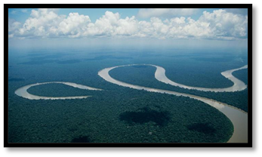
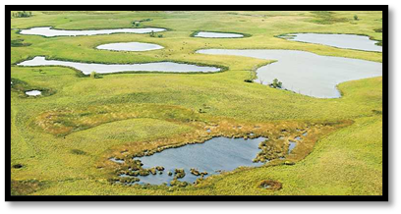
(a)(5) Waters: waters not identified in (a)(1) – (a)(4)
  Jurisdictional (a)(5) waters include intrastate lakes and ponds, streams, and wetlands not identified in the other jurisdictional categories, that meet either:
    The relatively permanent standard – i.e., the waters are a relatively permanent, standing or continuously flowing body of water with a continuous surface connection to an (a)(1) water or relatively permanent tributary. OR
    The significant nexus standard – i.e., the waters alone or in combination “significantly affect” an (a)(1) water. Waters under (a)(5) will generally be assessed individually.

Slide 36
(a)(5) Waters: waters not identified in (a)(1) – (a)(4)
  Relatively Permanent Standard
  Waters assessed under paragraph (a)(5) meet the relatively permanent standard if they are relatively permanent, standing or continuously flowing bodies of water with a continuous surface connection to a paragraph (a)(1) water or tributary that is relatively permanent.
    The agencies will assess waters under paragraph (a)(5) to determine if they are relatively permanent using a similar approach to the one described for tributaries in preamble section IV.C.4.
    The agencies will assess a continuous surface connection between waters assessed under paragraph (a)(5) and a paragraph (a)(1) water or a tributary that is relatively permanent using the approach described for adjacent wetlands in preamble section IV.C.5.
  Waters assessed under paragraph (a)(5) that do not meet the relatively permanent standard must be assessed under the significant nexus standard.

Slide 37
(a)(5) Waters: waters not identified in (a)(1) – (a)(4)
  Significant Nexus Standard
  Waters assessed under paragraph (a)(5) meet the significant nexus standard if they either alone or in combination with similarly situated waters in the region, significantly affect the chemical, physical, or biological integrity of paragraph (a)(1) waters.
  The 2023 Rule preamble explains the scope of significant nexus (i.e., which waters are “similarly situated” “in the region”).
    Waters assessed under paragraph (a)(5) will generally be assessed individually within the catchment of the tributary of interest.

Slide 38
Exclusions
  Excluded waters or features are not jurisdictional as “waters of the United States.”
  The final rule includes the pre-2015 regulatory exclusions, with modifications:
    Waste treatment exclusion, prior converted cropland exclusion
  The final rule includes regulatory exclusions for features that were “generally non-jurisdictional” under the pre-2015 regulatory regime:
    Certain ditches, certain artificially irrigated areas, certain artificial lakes and ponds, certain artificial reflecting and swimming pools, certain waterfilled depressions, certain swales and erosional features

Slide 39
(b)(1) Exclusion: Waste Treatment Systems
The final rule text excludes waste treatment systems, including treatment ponds or lagoons, designed to meet the requirements of the Clean Water Act.
The final rule preamble provides clarification on implementation:
  Excluded waste treatment systems do not sever upstream jurisdiction.
  The exclusion is generally available only to the permittee using the system for the treatment function for which such system was designed.

Slide 40
(b)(2) Exclusion: Prior Converted Cropland
  The final rule exclusion for prior converted cropland only covers wetlands.
  Wetlands can be covered under the prior converted cropland exclusion if they meet USDA’s longstanding definition of prior converted cropland.
  Prior converted cropland loses its exclusion status if there is a “change in use” – meaning the area is no longer available for the production of an agricultural commodity.

Slide 41
(b)(3) – (b)(8) Exclusions
  The final rule text specifies that features considered “generally non-jurisdictional” in the preamble to the pre-2015 regulations and in the pre-2015 guidance are excluded.
Ditches (including roadside ditches) excavated wholly in and draining only dry land and that do not carry a relatively permanent flow of water;
Artificially irrigated areas that would revert to dry land if the irrigation ceased;
Artificial lakes or ponds created by excavating or diking dry land to collect and retain water and which are used exclusively for such purposes as stock watering, irrigation, settling basins, or rice growing;
Artificial reflecting or swimming pools or other small ornamental bodies of water created by excavating or diking dry land to retain water for primarily aesthetic reasons;
Waterfilled depressions created in dry land incidental to construction activity and pits excavated in dry land for the purpose of obtaining fill, sand, or gravel unless and until the construction or excavation operation is abandoned and the resulting body of water meets the definition of waters of the United States; and
Swales and erosional features (e.g., gullies, small washes) characterized by low volume, infrequent, or short duration flow.

Slide 42
Effects of the Final Rule
Pursuant to Executive Orders 12866 (Regulatory Planning and Review) and 13563 (Improving Regulation and Regulatory Review), the agencies have prepared an Economic Analysis (EA) to inform the public of potential effects associated with this rulemaking.
In comparison to the pre-2015 regulatory regime, the agencies’ primary estimate is that the final rule will have de minimis impact.
  The agencies expect that there will be a slight and unquantifiable increase in waters being found to be jurisdictional under the final rule in comparison to the pre-2015 regulatory regime.
  These increases are related to implementation of the relatively permanent standard and the significant nexus standard.

Slide 43
Technical Support Document
The Technical Support Document provides additional detail on the existing scientific literature and technical information in support of the final rule.
The document utilizes the 2015 Science Report, Connectivity of Streams and Wetlands to Downstream Waters: A Review and Synthesis of the Scientific Evidence.
The agencies also reviewed and summarized relevant literature published since the 2015 Science Report’s release, which is overwhelmingly supportive of the conclusions of the Report and has expanded scientific understanding and quantification of functions that ephemeral streams and non-floodplain waters perform that affect the integrity of larger downstream waters, particularly in the aggregate.

Slide 44
Existing Jurisdictional Determinations
As of March 20, 2023, the date the 2023 Rule took effect, any approved jurisdictional determination completed must be finalized under the 2023 Rule, except in Idaho and Texas. In Idaho and Texas, the Corps will continue to utilize the AJD form used under the pre-2015 regulatory regime, also known as the Rapanos AJD form, until further notice.
As a matter of policy, AJDs are valid for a period of five years from the date of issuance, unless new information warrants revision of the determination before the expiration date, or a District Engineer identifies specific geographic areas with rapidly changing environmental conditions that merit reverification on a more frequent basis. Additionally, anyone with a valid AJD, may ask the Corps to reassess the parcel and issue a new AJD before the five-year expiration date.
However, after the 2020 NWPR was vacated by two district courts, the agencies clarified that the Corps will no longer rely on approved jurisdictional determinations issued under the 2020 NWPR in making new permit decisions.

Slide 45
Additional Resources: Implementation Memoranda
EPA and Army have prepared a new Coordination Memo to ensure consistency of jurisdictional determinations under the final rule.
EPA and Army have also partnered with USDA to prepare a new Ag Memo that clarifies the agencies’ roles and programs, and in particular clarifies the prior converted cropland exclusion under the final rule.
EPA and Army will continue to use the legal memorandum Waters That Qualify as “Traditional Navigable Waters” Under Section (a)(1) of the Agencies’ Regulations (formerly known as Appendix D) to provide guidance for identifying traditional navigable waters.
EPA and Army are also retaining the 2020 Ditch Exemption Memo clarifying implementation of the ditch exemption under Clean Water Act section 404(f).
https://www.epa.gov/wotus

Slide 46
Additional Information
Additional information is available at https://www.epa.gov/wotus
Rulemaking (https://www.epa.gov/wotus/revising-definition-waters-united-states)
  Federal Register notice
  Supporting documents including the Economic Analysis and Technical Support Document
  Summaries of Federalism and Tribal Consultation
  Fact sheets including an overview fact sheet, general agricultural fact sheet, and landowners’ fact sheet
Implementation (https://www.epa.gov/wotus/current-implementation-waters-united-states)
  Copies of the implementation memos

